Slide 1
Day 13-Agenda

Slide 2
Topics
Snowflake Roles and hierarchy
How can we create Roles, Users and assign permissions
What is READER Account
What is secure share and how it works
Data MASKING

Slide 3
Access control in SNowflake
Snowflake comes with a comprehensive collection of SQL commands for user and security management. These commands can only be run by users who have been given the OWNERSHIP privilege on the managed object as part of their role. The ACCOUNTADMIN and SECURITYADMIN roles are usually the only ones who can do this.
RBAC + DAC
In Snowflake, there are two approaches/methods to establish access control:
Discretionary Access Control (DAC): With each object, an Owner exists, responsible for granting access to the object.
Role-based Access Control (RBAC): The privileges to access the object is defined based on the Snowflake roles, assigned to the user by the company.

Slide 4
KEY ELEMENTS tO ACCESS CONTROL
Securable object: A secure object is one to which permission can be granted. Access will be refused unless a grant by the admin allows it.
Role: A role is a type of entity to which privileges can be assigned. It’s worth noting that roles can be given to other objects, forming a hierarchy.
Privilege: Privilege is a level of access to an object that is defined. To manage the granularity of access allowed, multiple separate privileges might be employed.
User: Snowflake recognizes a user’s identity, whether it’s affiliated with a person or a program.

Slide 5
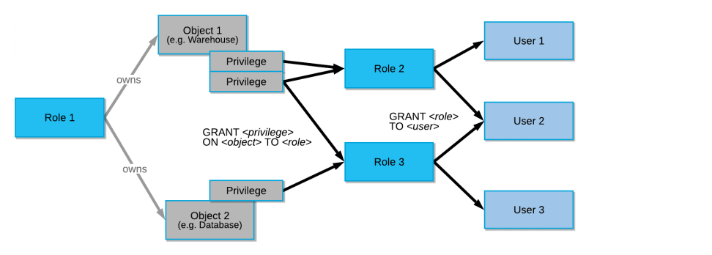
Roles privilege

Slide 6
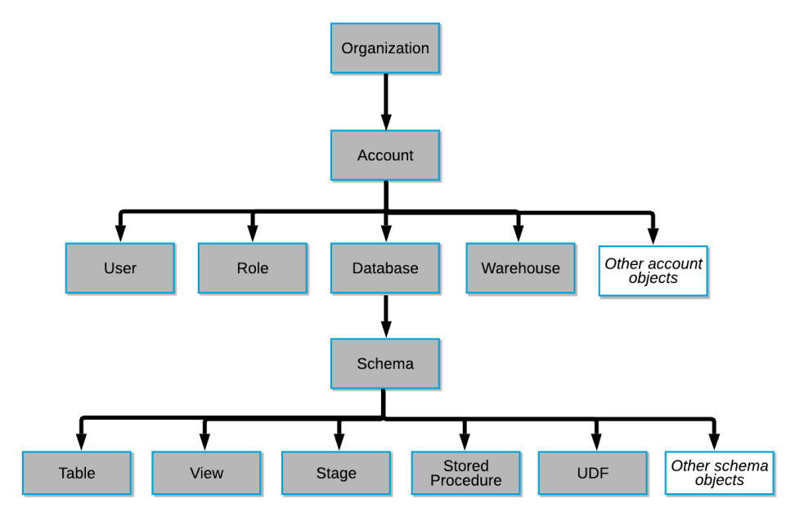
OBJECT Hierarchy

Slide 7
SYSTEM DEFINED ROLES
ORGADMIN: This role has operations authorization at a much higher level, and includes:
CREATTION & Reviewing accounts and managing them based on and outside of the organization.
Viewing the usage information on multiple accounts in the organization.
ACCOUNTADMIN: Role that encapsulates the system-defined roles SYSADMIN and SECURITYADMIN. It’s the highest-level job in the system, and it should only be given to a small number of users in your account.
SECURITYADMIN: Create, monitor, and manage users and roles, as well as manage any object grant globally. In more detail:
The MANAGE GRANTS security privilege given to this role allows to change or revoke any grant.
Through the system role hierarchy, the role inherits the rights of the USERADMIN role (e.g. USERADMIN role is granted to SECURITYADMIN)

Slide 8
System defined roles part 2
USERADMIN: This role is limited to only user and role management. In more detail:
The role grants the user give the CREATE USER and CREATE ROLE security access.
The role can create new users and roles
SYSADMIN: In an account, this role has the ability to construct warehouses, databases, and other objects. If you establish a role hierarchy that assigns all custom roles to the SYSADMIN role, as recommended, this role can also provide privileges to other roles on warehouses, databases, and other objects.
Public: Every user and role in your account is immediately assigned a pseudo-role. The PUBLIC position, like any other role, can own secure objects; however, the objects owned by the role are, by definition, accessible to all other users and Snowflake roles in your account. When explicit access control is not required and all users are treated equally in terms of access permissions, this role is often utilized.

Slide 9
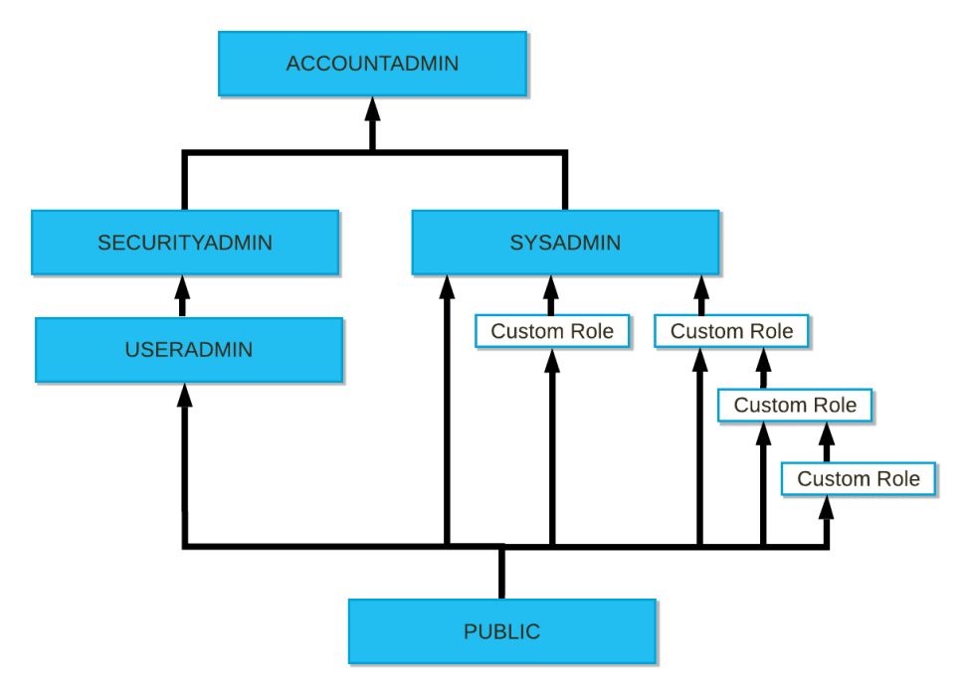

Slide 10
DYNAMIC DATA MASKING
Snowflake Dynamic Data Masking (DDM) is a data security feature that allows you to alter sections of data (from a table or a view) to keep their anonymity using a predefined masking strategy.
Data owners can decide how much sensitive data to reveal to different data consumers or data requestors using Snowflake’s Dynamic Data Masking function, which helps prevent accidental and intentional threats. It’s a policy-based security feature that keeps the data in the database unchanged while hiding sensitive data (i.e. PII, PHI, PCI-DSS), in the query result set over specific database fields.

Slide 11
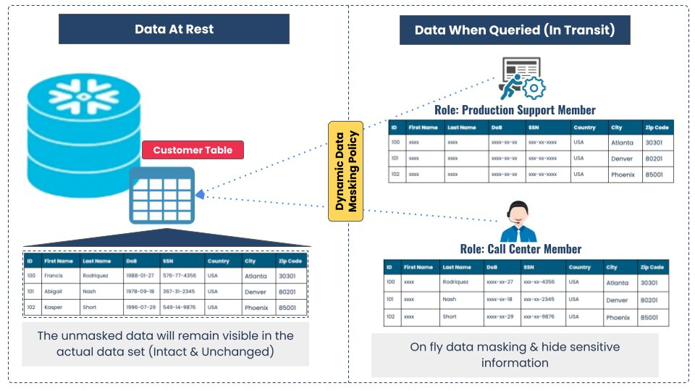

Slide 12
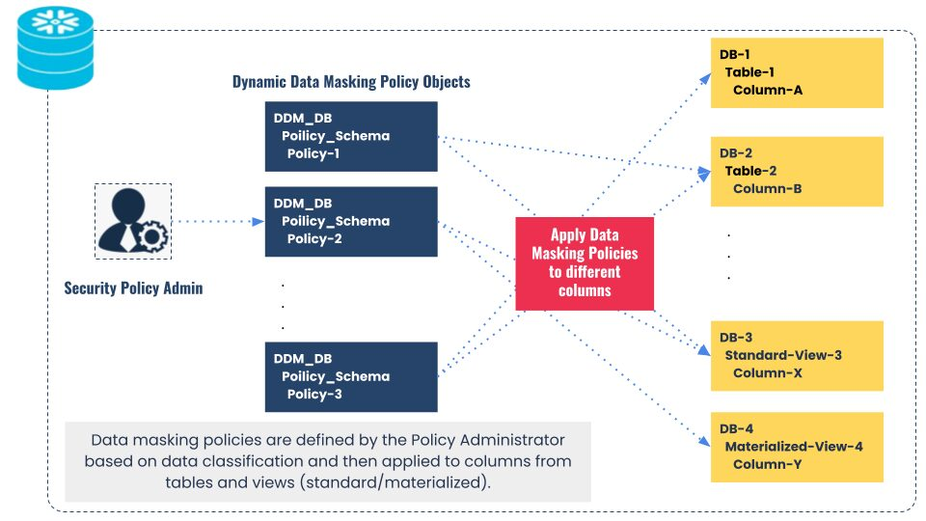
HOW DDM works

Slide 13
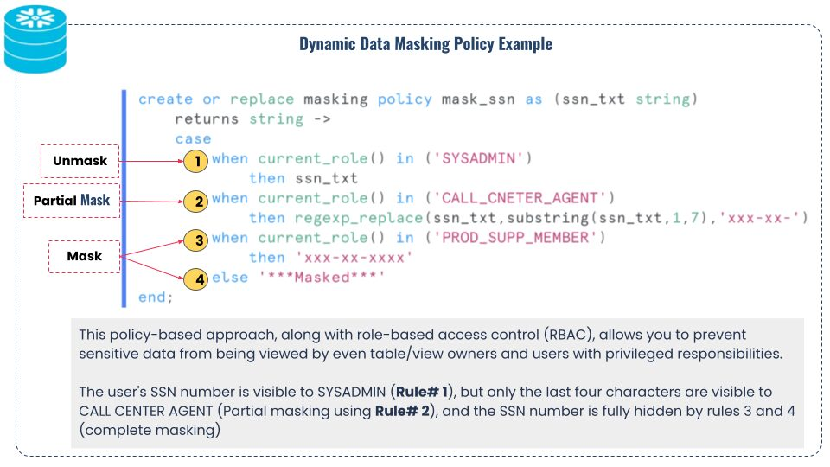
Example

